Slide 1



Hate Speech Analysis
Use this section to delve into the analysis of hate speech, its impact, and potential solutions. Explore the complexities and challenges associated with identifying and addressing hate speech in various contexts.
by Sundaraselvam P

Slide 2

Contextual Analysis
Data Preparation
Importing necessary libraries like pandas, numpy, spacy, and sklearn.
Defining a custom tokenizer using spaCy for text preprocessing.

Slide 3

Text Processing
Reading text files and metadata from a dataset: The process involves accessing the dataset containing text files and associated metadata, which is crucial for understanding the context and source of the text data.
Applying the custom tokenizer to preprocess the text data: Utilizing a custom tokenizer, specifically designed using spaCy, to carry out text preprocessing tasks such as tokenization, lemmatization, and removing stop words to enhance the quality of the text data for further analysis.

Slide 4
Sentiment Analysis
1
Text Preprocessing
Utilizing TextBlob to analyze the sentiment of the preprocessed text involves the initial step of cleaning and preparing the text data for sentiment analysis. This includes tasks such as tokenization, removing stop words, and lemmatization to ensure accurate sentiment analysis results.
2
Sentiment Analysis
Once the text is preprocessed, TextBlob is used to analyze the sentiment of the text. This step involves determining the polarity and subjectivity of the text, providing insights into the overall sentiment expressed in the preprocessed data.
3
Result Interpretation
After conducting sentiment analysis, the results are interpreted to understand the emotional tone and attitude conveyed in the text. This step helps in gaining valuable insights into the sentiment of the preprocessed text data.

Slide 5
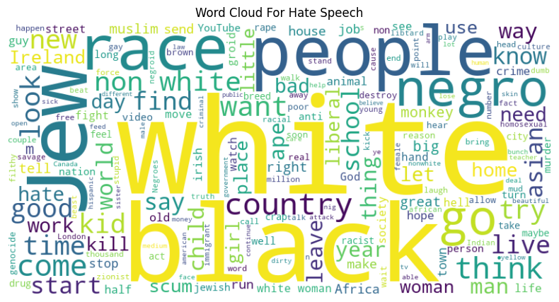
Topic Modeling
Implementing TF-IDF vectorization and Latent Dirichlet Allocation (LDA) for topic modeling.
Visualizing topics and creating a word cloud for hate speech1.

Slide 6
Temporal Analysis
Data Import and Preprocessing
The code begins with importing necessary libraries and reading a CSV file into a pandas DataFrame. It also includes a function to read text from files based on file_id1.
Text Analysis and Time Extraction:
A new column actual_text is created by applying the read_text_from_file function. The code then extracts dates from the text using the datefinder library and fills missing values.

Slide 7

Text Analysis and Time Extraction
The code begins with importing necessary libraries and reading a CSV file into a pandas DataFrame. It also includes a function to read text from files based on file_id1.
A new column actual_text is created by applying the read_text_from_file function. The code then extracts dates from the text using the datefinder library and fills missing values.

Slide 8
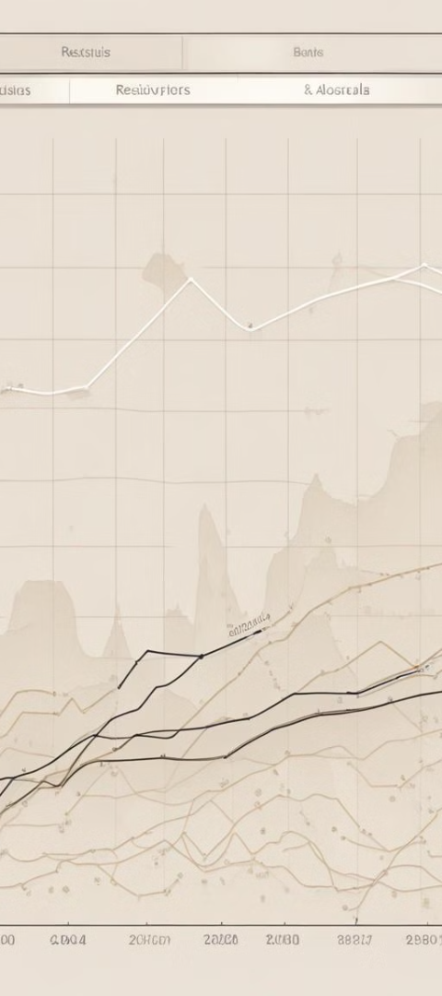
Time Series Analysis
1
Dataframe Indexing
The DataFrame is indexed by time values to organize the data for analysis. This step ensures that the time series data is structured and can be easily manipulated for further processing.
2
Daily Frequency Resampling
The time series data is resampled to a daily frequency to provide a more granular view of hate speech occurrences over time. This step allows for a detailed analysis of the frequency and patterns of hate speech incidents.
3
Decomposition of Time Series
The time series is decomposed into trend, seasonality, and residuals to gain insights into the underlying patterns and fluctuations in hate speech occurrences. This analysis helps in understanding the overall trends and periodic variations in the data.

Slide 9

Stationarity Test and Correlation Plots
Augmented Dickey-Fuller Test: The time series data is subjected to an Augmented Dickey-Fuller test to assess its stationarity. This test is crucial for determining the presence of a unit root in the data, which is indicative of non-stationarity.
Autocorrelation Plots: Following the stationarity test, autocorrelation plots are generated to visualize the correlation of the time series data with a lagged version of itself. This helps in identifying any patterns or dependencies within the data.
Partial Autocorrelation Plots: Additionally, partial autocorrelation plots are created to display the correlation between the observations at a given lag while accounting for the correlation at shorter lags. This aids in understanding the direct relationship between data points at different time intervals.

Slide 10
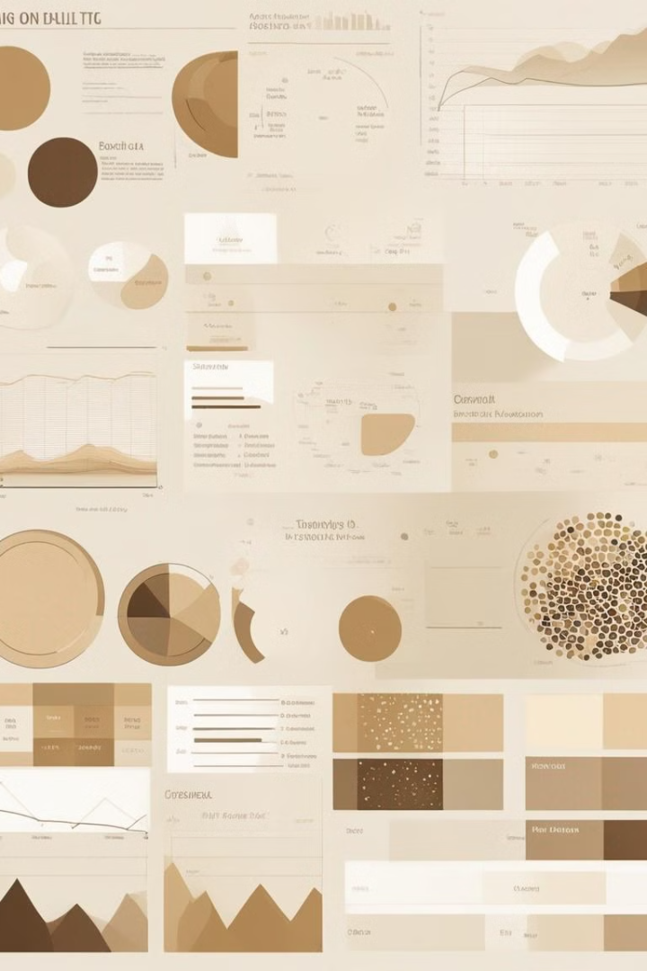
User Profiling
Libraries such as pandas, matplotlib, and seaborn are imported for data manipulation and visualization. The dataset ‘Annotations_Metadata.csv’ is loaded, and initial preprocessing includes encoding the ‘label’ column using LabelEncoder.

Slide 11
Data Overview
Dataset Columns
Label Encoding
The dataset contains columns like ‘file_id’, ‘user_id’, ‘subforum_id’, ‘num_contexts’, and ‘label’.
After encoding, a new column ‘label_encoded’ is added to represent ‘hate’ and ‘noHate’ numerically.

Slide 12

User Behavior Analysis
1
Data Grouping
2
New Columns
Data is grouped by ‘user_id’ to calculate the total contexts, mean, and sum of hate speech instances.
New columns ‘total_contexts’, ‘hate_speech_propensity’, and ‘total_hate_speech’ are created for further analysis.

Slide 13
Visualization of Results
Histogram Plot
Insights
A histogram is plotted to visualize the distribution of hate speech propensity across users.
The plot helps in understanding the spread and central tendencies of user behavior regarding hate speech.

Slide 14
Hate Speech Detection Model
1
Data Preparation
2
Model Building
Import necessary libraries and load the dataset. Preprocess text data using spaCy for tokenization.
Encode labels and split the dataset for training and testing. Construct a model using DistilBERT and train it on the processed data.

Slide 15

Model Evaluation
1
Assessing Performance
Assess model performance with accuracy score and classification report.
2
Analysis of Misclassifications
Analyze false positives/negatives to understand misclassifications.

Slide 16

Conclusion
Promising Results
The model shows promising results but has room for improvement, especially in reducing false classifications.

